Slide 1
Meat Inspection Officer Comments
August 1, 2022

Slide 2
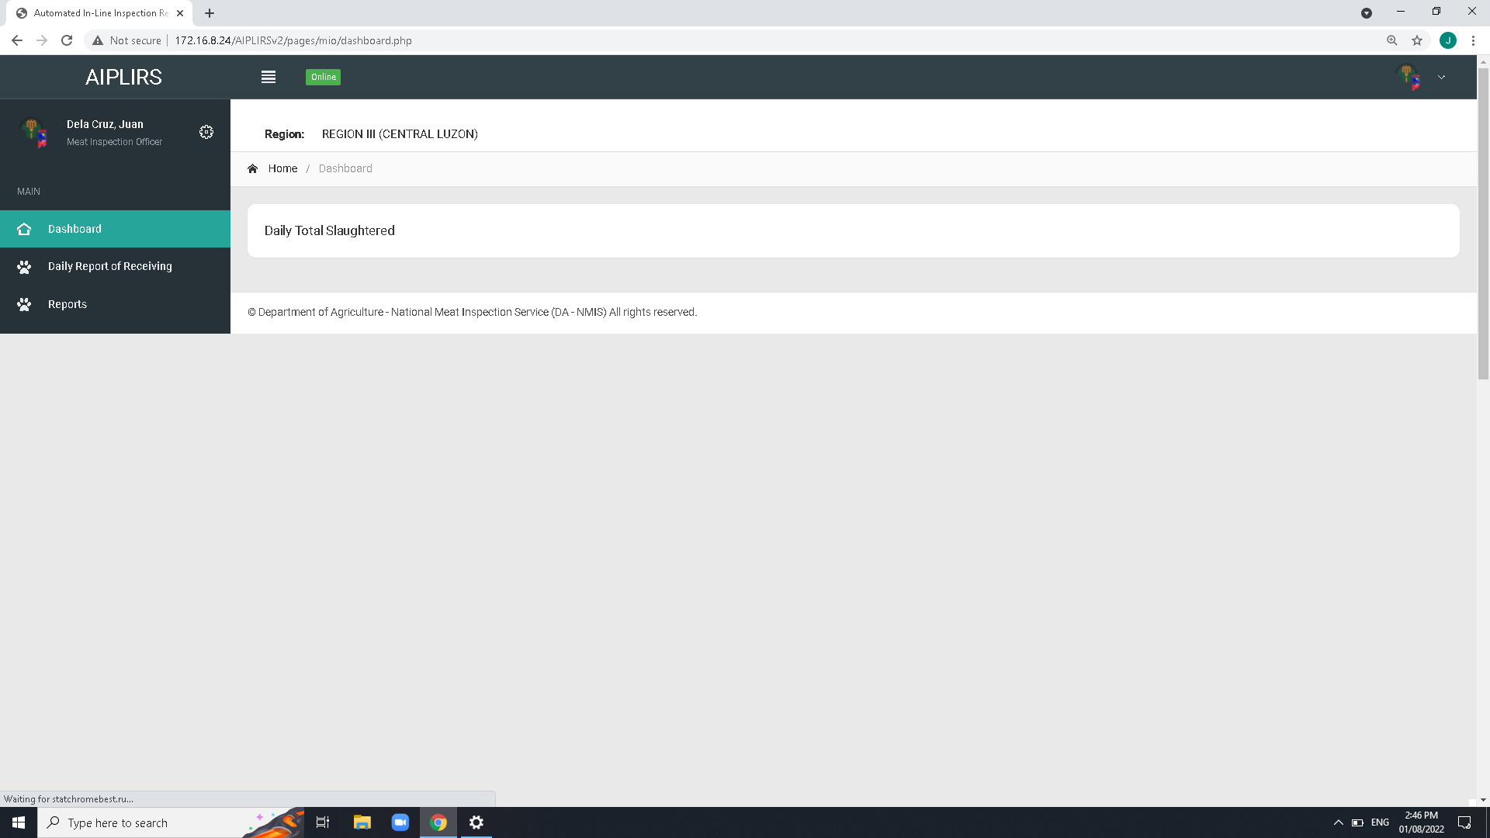
Dashboard Page
To be added on MIO account sidebar:
Output is the summary on the all Meat establishment assignment base on dates
(suggestions: tick boxes for the Current, previous)
Remove Navigation bar header and breadcrumbs on all pages
Create a summary card for the receiving, fit for slaughter, fit for human consumption

